Slide 1


The Ocean of Information aims to introduce you to the most popular information sources
and helps you to see how each might be useful in the context of your academic studies.
Click in the boxes below to find out more. Click on the button to return to this page.
Social Media
Personal Communications
Newspapers
Websites
Magazines
Audio-Visual Information
Maps
Diving deeper into academic research
Reference Sources
Trade & Professional Journal Articles
Academic Textbooks
Peer-Reviewed Journal Articles
Conference Papers
Underwater Scenery by Rafae|. Licensed by CC BY 2.0

Slide 2
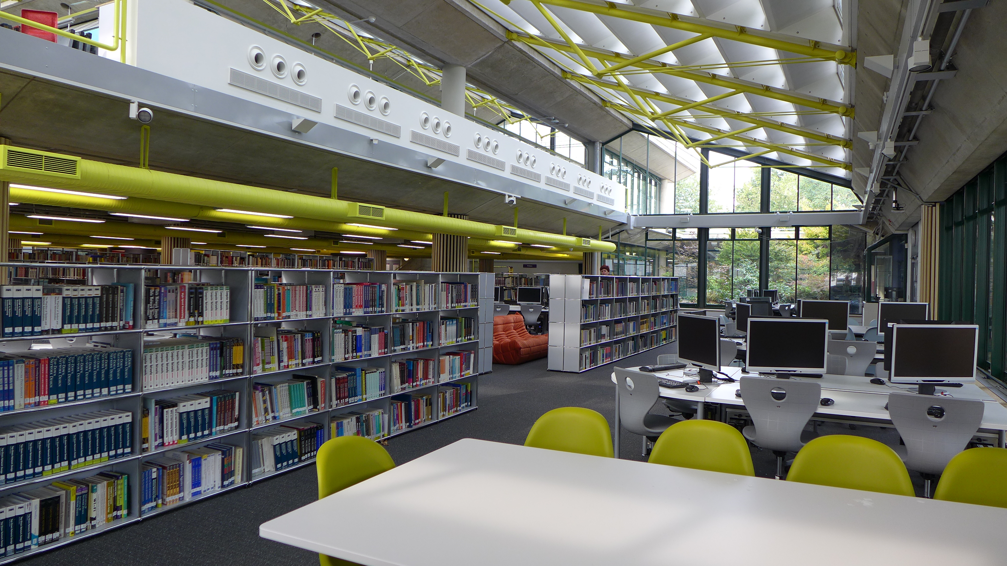


Useful for finding out what
others are thinking.
These include blogs, and tools for sharing photos and information
amongst friends and groups.
Find out how to reference
social media and blogs resources
Social Media
Use with caution in your research.
How reliable is the information?
People’s thoughts and feelings can
change too!
Social media channels may be the subject of your research, e.g. you may be studying how people present themselves on Instagram.
Why not follow UoP Library on your favourite social networking resource: Liblog, Facebook, Twitter, YouTube or Instagram?

Slide 3

You may use these to add a personal or primary research element to your work.
They could be letters, emails or
they could be opinions gathered
from a survey or interview.
Find out how to refer to
personal and other communications.
Personal Communications
Find out how to conduct good quality surveys and interviews using Sage Research Methods database.
You should always ask permission
prior to including personal details
in your work. Contributors may
prefer to remain anonymous.

Slide 4

As well as providing information on current affairs, newspapers are useful sources of public opinion and include reviews. They can be useful for historical research, providing primary evidence from the period in which they were published.
Newspapers may be local
or national, tabloid or broadsheet, they may also be specialist, e.g. The Stage.
Find out how to reference newspaper articles
Newspapers
Find and read full text newspaper articles
from all over the world using Nexis Uni database or Pressreader
Tabloids and broadsheets are written
for different audiences. Compare
news stories from tabloids, or ‘red
tops’, such as the Sun and the Mirror
with ‘broadsheets’ such as the Times
and the Guardian.
You may find other recommendations for newspaper archives on the
Subject pages.

Slide 5

This page looks at the internet in general, not as a medium
for accessing the Library’s online scholarly books and journals.
Use the web to find quick facts,
current information, information
about companies and organizations
and information from the government.
Use the advanced search options to
find what you need more quickly and easily.
Search by domain name, if appropriate, e.g.:
.ac.uk UK academic sites
.gov.uk UK government
.org.uk UK non-profit making organisations
.co.uk UK companies
Find out how to reference webpages, websites and blogs
Websites
Always evaluate the information
that you find on the web. Ask questions such as who is responsible for the site, why have they written it, how up-to-date is it. For more information take a look at the guide Evaluating Internet Sources.
Find good quality websites
recommended by your librarian on the Subject pages of the library website.

Slide 6

Magazines are usually aimed at the general public, but can have a place in student research. Vogue, for example, will be useful for fashion students.
Use these to keep up with changing
trends, ideas or public opinions.
They are usually published
weekly or monthly.
Find out how to reference magazine articles
Magazines
Some magazines have their
own websites where you can
read sample articles and view
additional information.
Articles vary in length
and will usually be written
by journalists.
They are usually available in printed format or as personal electronic subscriptions. Sometimes they are available as library electronic subscriptions.
Find magazine articles
by searching Discovery. When you see your search results, limit by source types to magazines.
Assist Me / Fashion Shoot / Blank Mag by Simon Pais-Thomas, Flickr

Slide 7
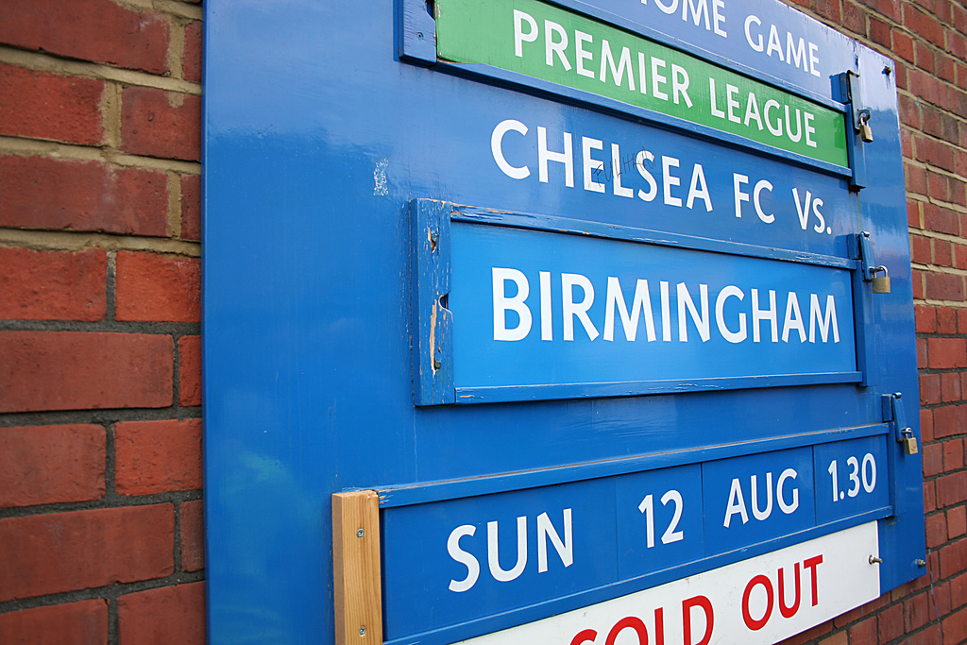
Visual arts students might use this for
inspiration for their design work.
Others may use it to illustrate particular
points within presentations or research.
It may also help with learning a language.
A-V information may be images, video clips, podcasts, computer games; any non-textual information.
Images may be from printed
or electronic sources.
Find out how to reference images and other audio-visual resources
Audio-Visual Information
Images, just like other information sources, will be subject to copyright even if they are available on the web.
You can find A-V information on Discovery. Limit your source type to non-print resources, audio or videos. You may also see some related images in the right-hand column.
The library has some good quality image, video and sound resources for educational use. A good place to start is the Visual Culture Subject Page. For television and radio broadcasts, use Box of Broadcasts (BoB).
First Home Game 07-08 Season by diana tri wulandari, Flickr

Slide 8
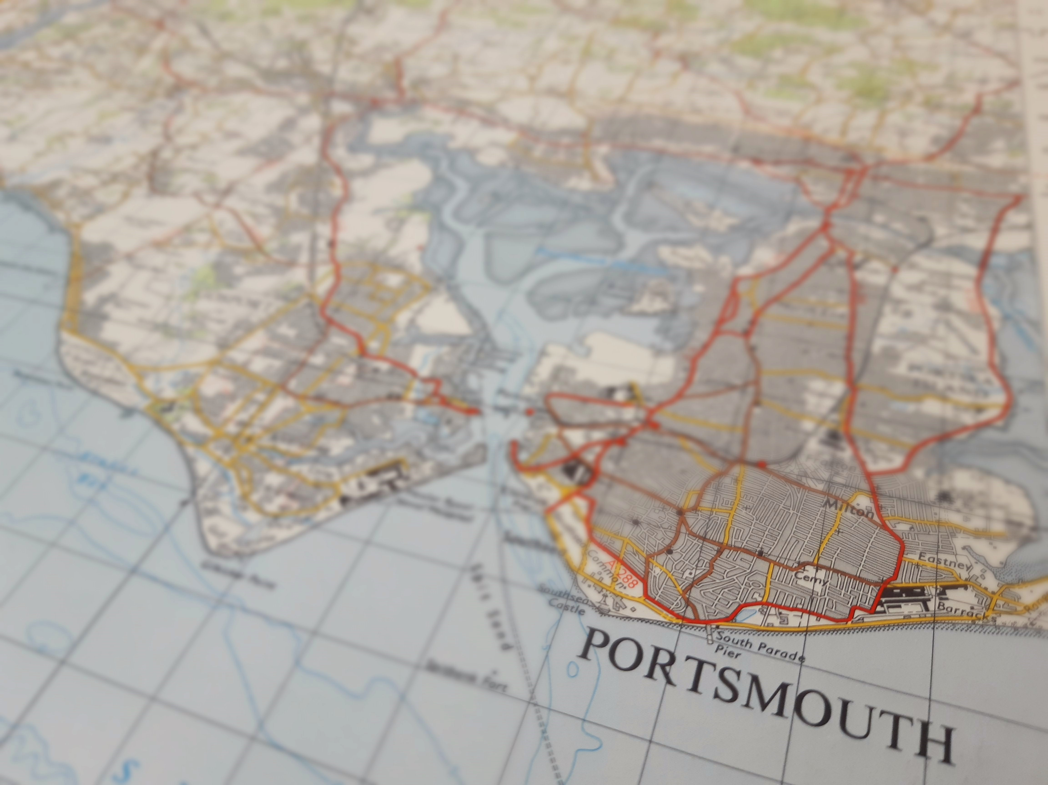

Maps provide context to a place, time and a narrative. They can show complex information in a graphical form.
Maps can be topographic (showing general landscape features) or thematic (portraying a specific topic or theme).
Find out how to reference maps.
Maps can be printed or electronic.
Maps
Most of our printed maps are Library Use only, although a few may be found on Discovery. Limit your source type to maps. If you can’t find what you want, ask the Map Librarian.
The Library has access to high quality mapping of Great Britain via the Digimap collections.
Find good quality worldwide electronic maps resources on the Useful Links section of the Map Library web page.

Slide 9
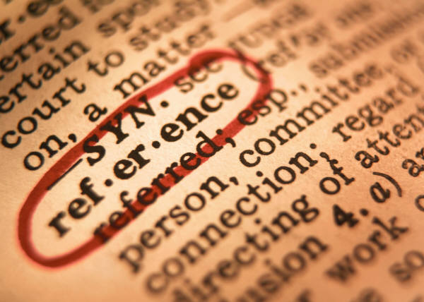
Use these to find quick facts. They are useful to consult at the planning stage of your research and can provide you with keywords to help you search the web or library catalogues and databases effectively.
These include dictionaries, encyclopedias and directories.
Find out how to reference dictionary and encyclopedia entries.
Resources may be printed or electronic
Reference Sources
If you search Discovery you will sometimes see a link to your topic in Credo Reference. Look for it in the right hand column. You may also see a research starter as the first hit in your search results.
Use Credo Reference database to search an online library of reference resources. If you
just want a dictionary try the Oxford English
Dictionary, OED Online.

Slide 10

Use these journals to give a
professional view point to your work.
They contain information aimed at
people working in a particular trade
or profession.
They are published regularly, usually
weekly or monthly.
Articles vary in length, but are
often fairly short and readable.
They may be printed or electronic.
They include product reviews,
industry news, exhibition and
competition adverts. Job
adverts are also featured.
Trade and Professional Journals
Usually referenced as journal articles but sometimes as magazines articles.
Articles are not peer reviewed, but
are usually written by people with
a sound knowledge of the industry.
You might want to regularly browse some trade journals relating to your industry. Find them on the journal display shelves in the library or online.
You can use tools called databases
to help you search the contents
of these and other types of journal.
Visit the Subject pages to find specific databases for your subject area.
You can find journal articles
in any subject area by searching
Discovery. Limit your source type to trade publications.

Slide 11

Use these when you want an introduction
to a topic area. You are unlikely to read a book from cover to cover. Use the contents page and index to help you locate what you want to find out about.
They present well established ideas
and theories and usually cover a
broad topic area in considerable detail.
Find out how to reference
books, including chapters in edited books.
Academic Textbooks
Format may be printed
or electronic.
They are reviewed by an editorial
board so you can usually trust that the content is reliable and accurate.
The book may be edited and
divided into chapters which are
written by different authors
but relate to the main theme.
Find out what books are available by
searching Library Hub Discover or an online bookshop such as Blackwell’s.
Use the Library Catalogue to find printed or electronic books in the University of Portsmouth Library. Alternatively search Discovery and limit your source type to books and ebooks.

Slide 12

Articles are peer reviewed, i.e. the quality of the article has been reviewed by an editorial board of experts in that subject.
Use these when you know that you
want specific, academic information.
They are published regularly,
usually monthly or quarterly.
Peer-Reviewed Journal Articles
Find out how to reference journal articles
They contain articles,
written by academics.
The sources used to write
the articles are included
at the end in a Reference
List or Bibliography.
They may be in printed
or electronic format.
If you are an undergraduate,
you are unlikely to browse
scholarly journals.
You can find scholarly articles
in any subject area by searching
Discovery. Limit your source type to academic journals.
You can use tools called databases
to help you search the contents
of these and other types of journal.
Visit the Subject pages to find specific databases for your subject area.

Slide 13
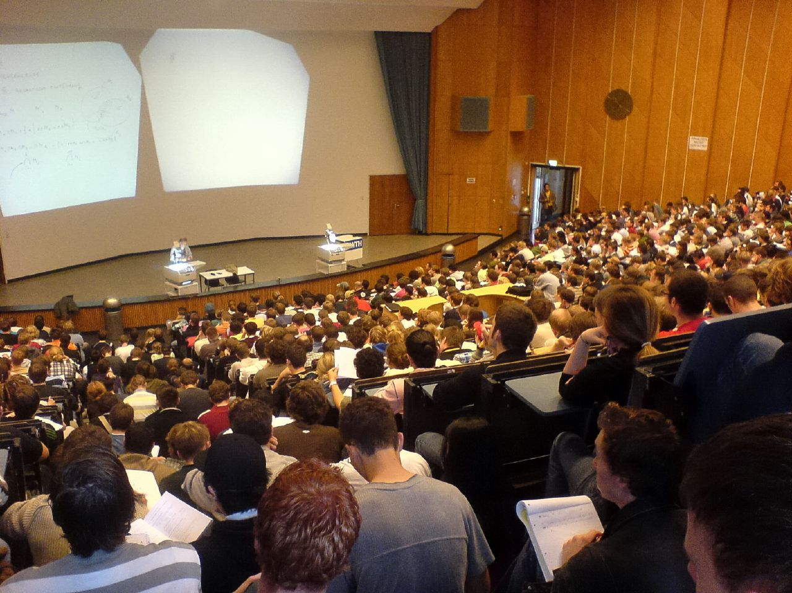
Refer to these if your topic of interest is very new and
little has been written about it in books and journals.
Academics present new
ideas and research at
conferences.
Find out how to reference conference presentations and proceedings
Conference Papers
Papers are presented and
usually written up and published
as ‘proceedings’ which are often peer-reviewed
There are opportunities for
debates and discussions to
progress new ideas too.
If you are searching Discovery, choose conference materials as the source type.
If you want to find conference papers, Web of Science and Scopus are two databases which index conference proceedings amongst other scholarly sources.
Crowded Math Course by thowi, Flickr

